Slide 1





THEORY
Training Program 01
Advanced NLP & Large Language Models (LLMs)

Slide 2
THEORY
Training Program 01
M01: Text Preprocessing
M02: Word and Sentence Embeddings
M03: Transformer Architectures
M04: Entity-Centric NLP
M05: Applied NLP Tasks
M06: Multimodal NLP
M07: LLM Fundamentals
M08: Prompt Engineering
M09: Fine-Tuning & PEFT
M10: RAG & Real-World Projects

Slide 3
MODULE M01
TEXT PREPROCESSING
CHAPTER M01.2
BPE Byte Pair Encoding

Slide 4
THEORY
Training Program 01
1. Getting Started with Text Processing
2. Fundamentals of Tokenization
3. Byte-Pair Encoding (BPE) and Subword Tokenization
4. Advanced Subword Tokenization with SentencePiece
5. Stopwords and Vocabulary Management
6. Processing Multilingual and Cross-Lingual Text
7. Summary and Next Steps

Slide 5
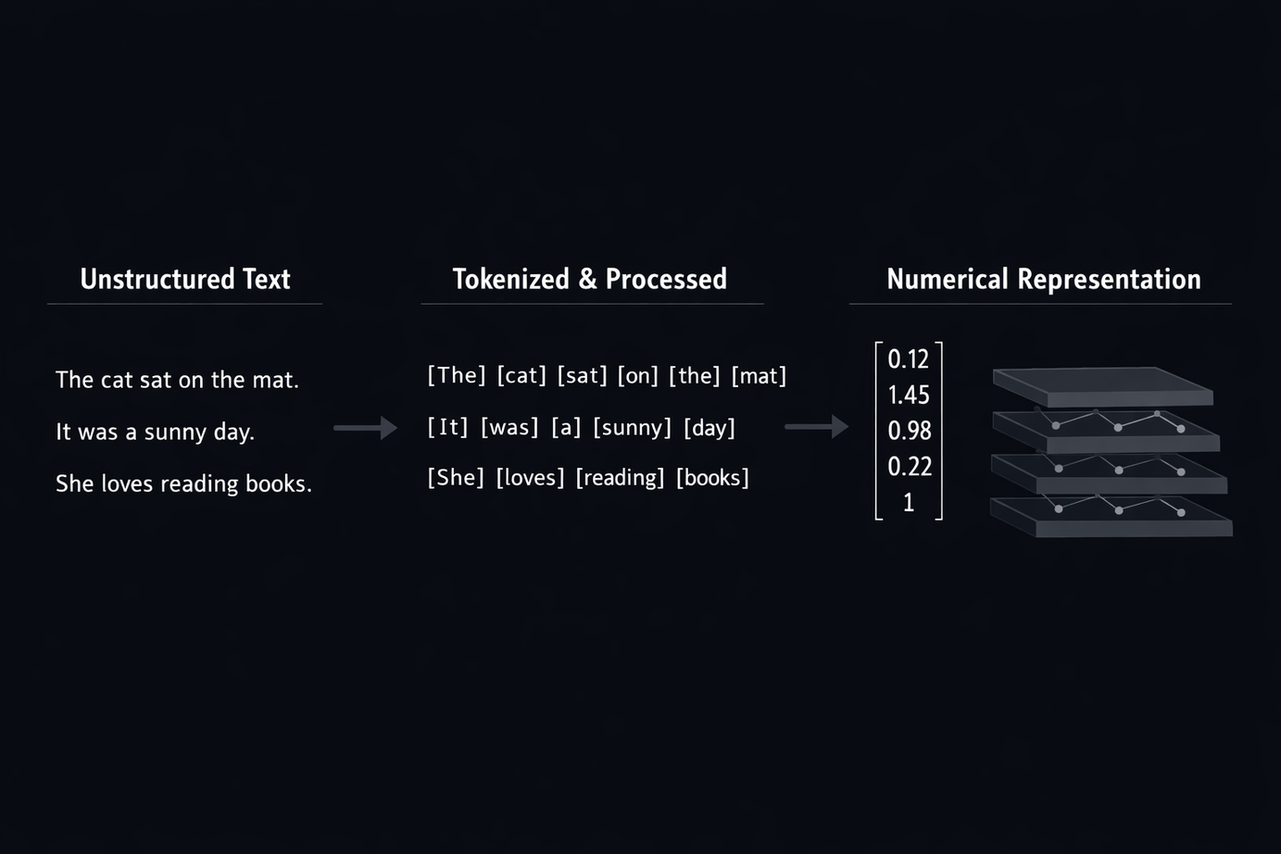
M01.1 BPE
Chapter 1.1 Getting Started with Text Processing.
Text processing is not a preliminary task, but the foundation of all modern NLP systems.
Before any model can learn, raw human language must be transformed into a structured numerical form.
This transformation defines what a model can and cannot understand.

Slide 6

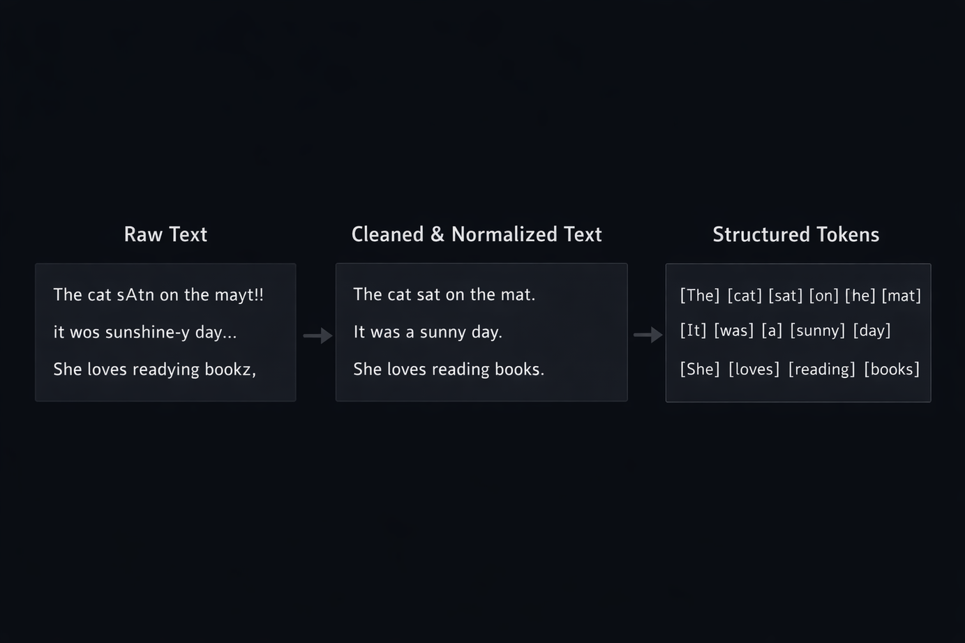
M01.1 BPE
Chapter 1.1 Getting Started with Text Processing.
The goal of preprocessing is to convert raw text into structured, machine-readable units.
While preserving as much semantic and structural information as possible.
This step determines the quality and limits of the entire model.

Slide 7
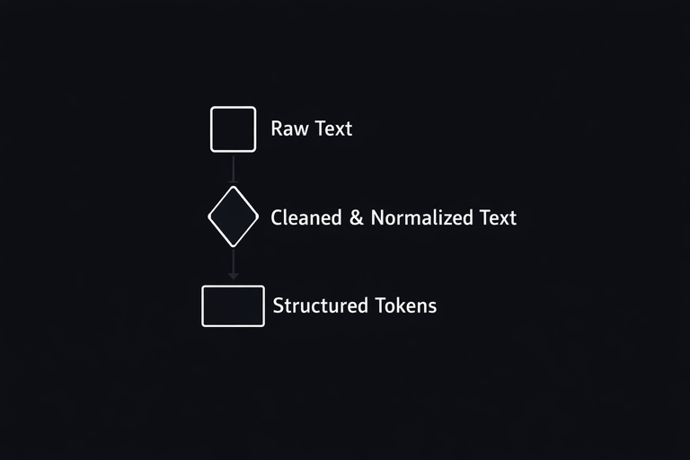
M01.1 BPE
Chapter 1.1 Getting Started with Text Processing.
Cleaning and normalization of noisy text.
Definition of tokens and vocabulary.
Preparation for numerical embedding and vectorization.

Slide 8
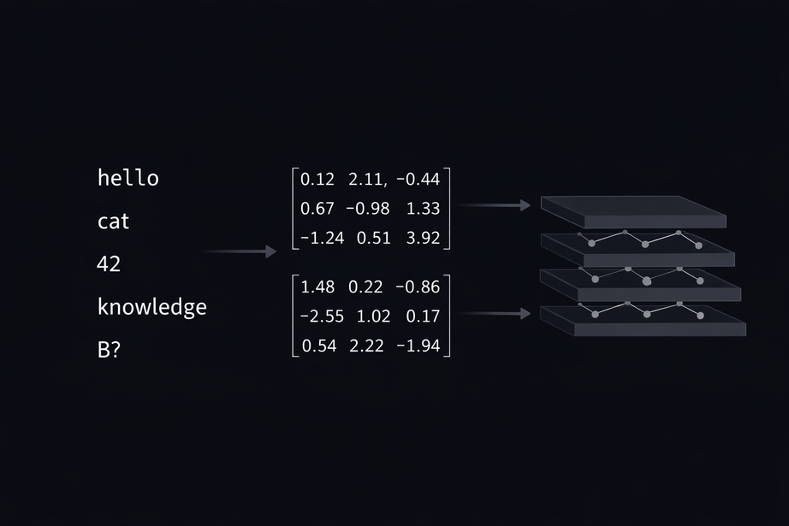
M01.1 BPE
Chapter 1.1 Getting Started with Text Processing.
Neural networks do not understand symbols or words.
They operate exclusively on numerical tensors.
Preprocessing defines how language is translated into numbers, and therefore defines the model’s perception of reality.

Slide 9
THEORY
Training Program 01
1. Getting Started with Text Processing
2. Fundamentals of Tokenization
3. Byte-Pair Encoding (BPE) and Subword Tokenization
4. Advanced Subword Tokenization with SentencePiece
5. Stopwords and Vocabulary Management
6. Processing Multilingual and Cross-Lingual Text
7. Summary and Next Steps

Slide 10
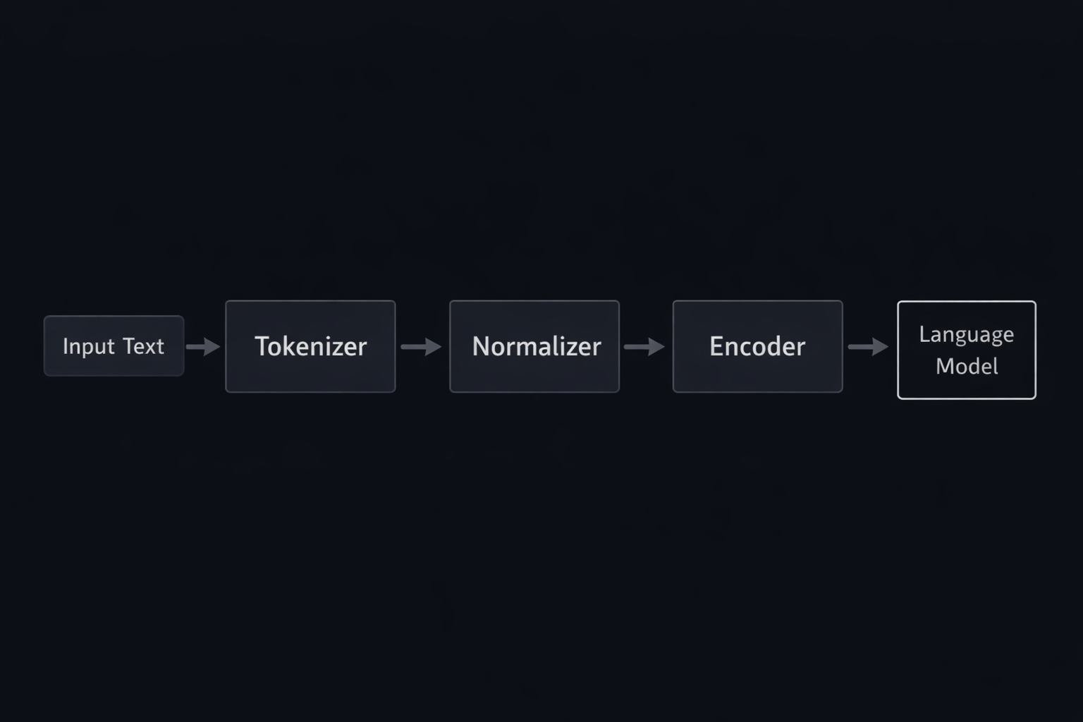
M01.1 BPE
Chapter 1.2 Fundamentals of Tokenization
Modern LLM pipelines rely on highly optimized libraries to ensure efficiency, consistency, and reproducibility.
These tools define how text becomes training-ready data.

Slide 11
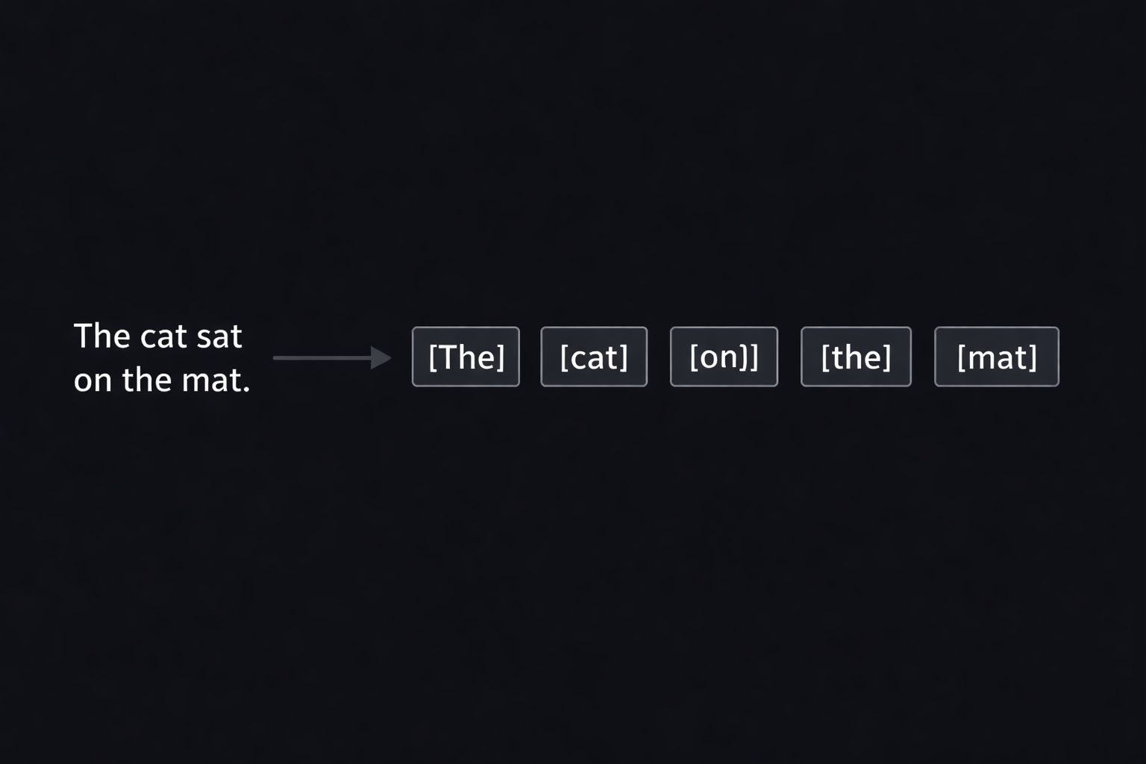
M01.1 BPE
Chapter 1.2 Fundamentals of Tokenization
Tokenization is the deterministic process of splitting text into discrete units called tokens.
These tokens are the atomic elements used by language models to represent and process human language.

Slide 12
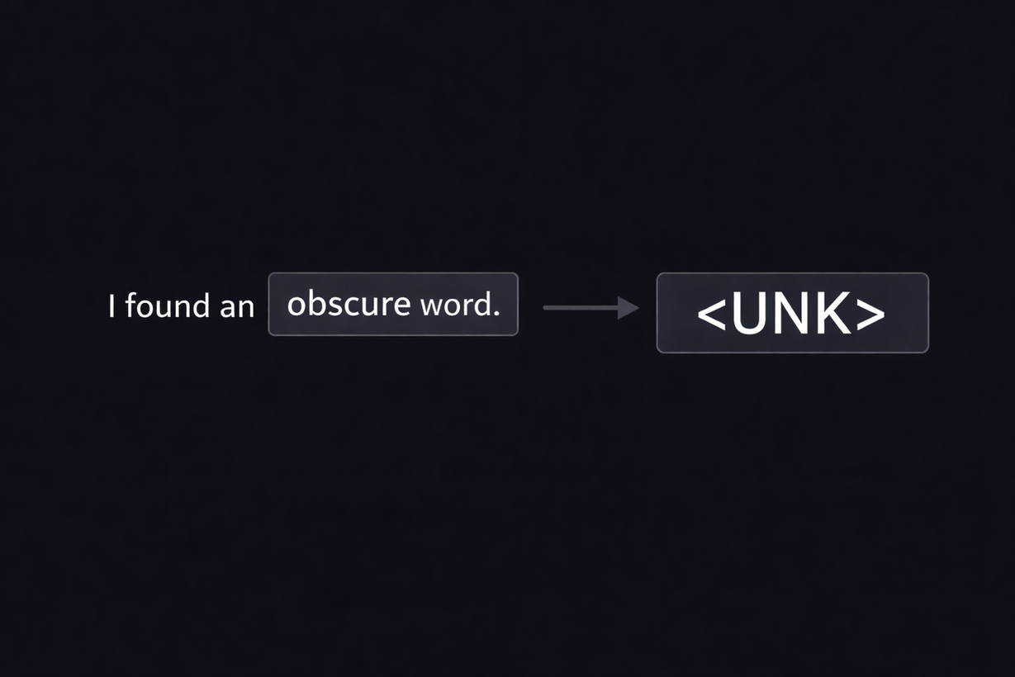
M01.1 BPE
Chapter 1.2 Fundamentals of Tokenization
Word-level tokenization fails when encountering words that are not present in the training vocabulary.
These unknown tokens reduce model performance and limit generalization to new data.

Slide 13
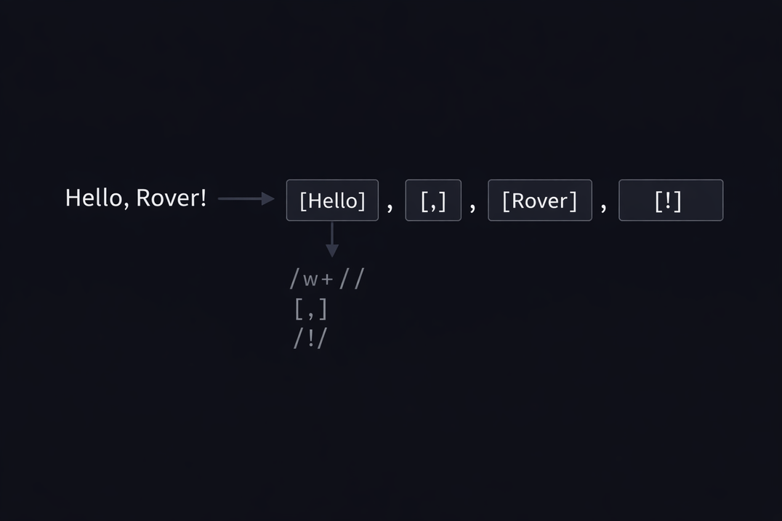
M01.1 BPE
Chapter 1.2 Fundamentals of Tokenization
Rule-based tokenizers use predefined patterns to split text while preserving punctuation and structure.
Regular expressions allow precise control over how symbols, spaces, and contractions are handled.

Slide 14
THEORY
Training Program 01
1. Getting Started with Text Processing
2. Fundamentals of Tokenization
3. Byte-Pair Encoding (BPE) and Subword Tokenization
4. Advanced Subword Tokenization with SentencePiece
5. Stopwords and Vocabulary Management
6. Processing Multilingual and Cross-Lingual Text
7. Summary and Next Steps

Slide 15
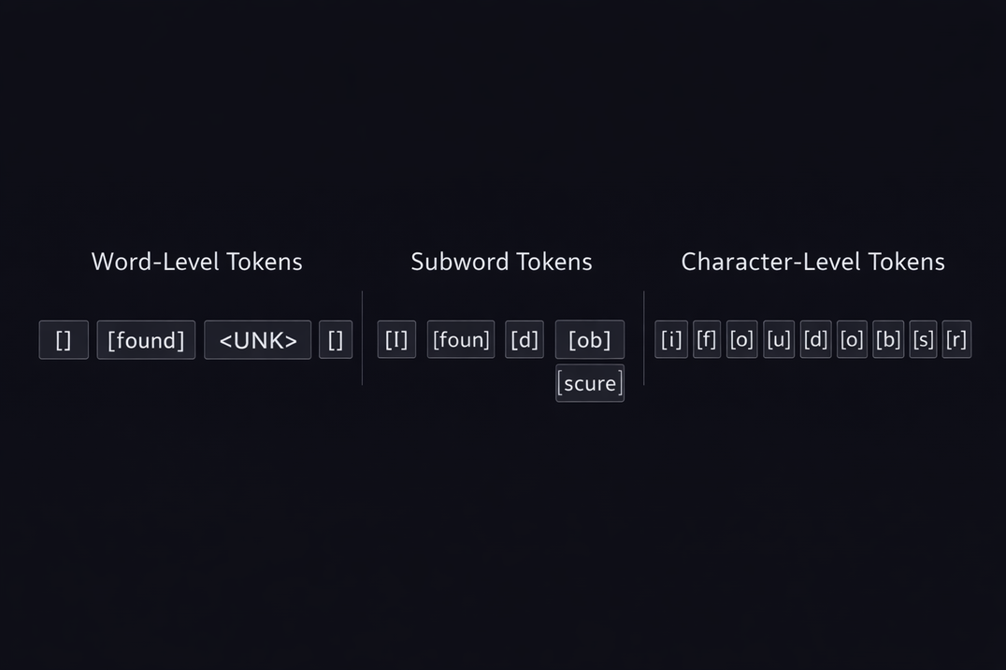
M01.1 BPE
Chapter 1.3 Byte-Pair Encoding (BPE) and Subword Tokenization
Subword tokenization was introduced to balance the limitations of word-level and character-level approaches.
It enables models to represent any word while preserving meaningful linguistic units.

Slide 16
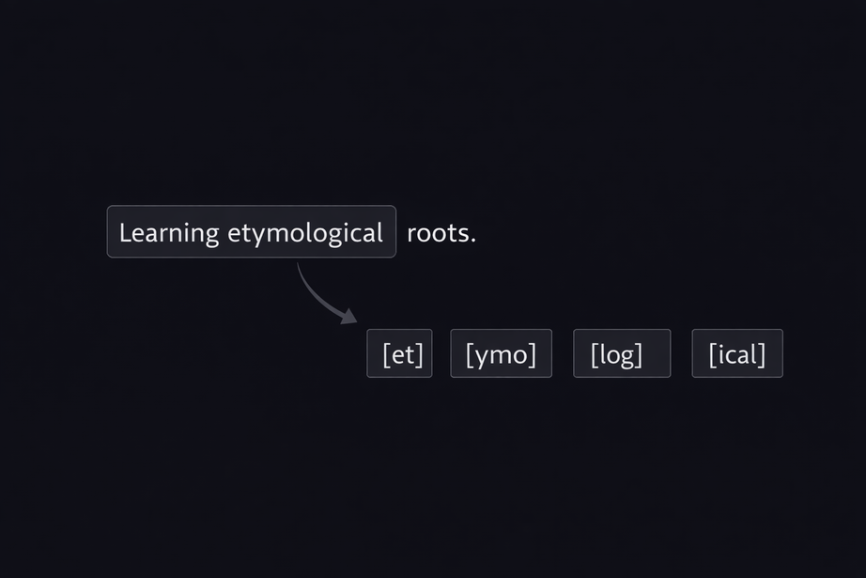
M01.1 BPE
Chapter 1.3 Byte-Pair Encoding (BPE) and Subword Tokenization
Handling the Out-of-Vocabulary (OOV) Problem
Word-level tokenization fails on unseen or rare words.
Unknown tokens reduce model accuracy and robustness.
Subword tokenization decomposes unknown words into known units.
This guarantees full coverage of any input text.

Slide 17
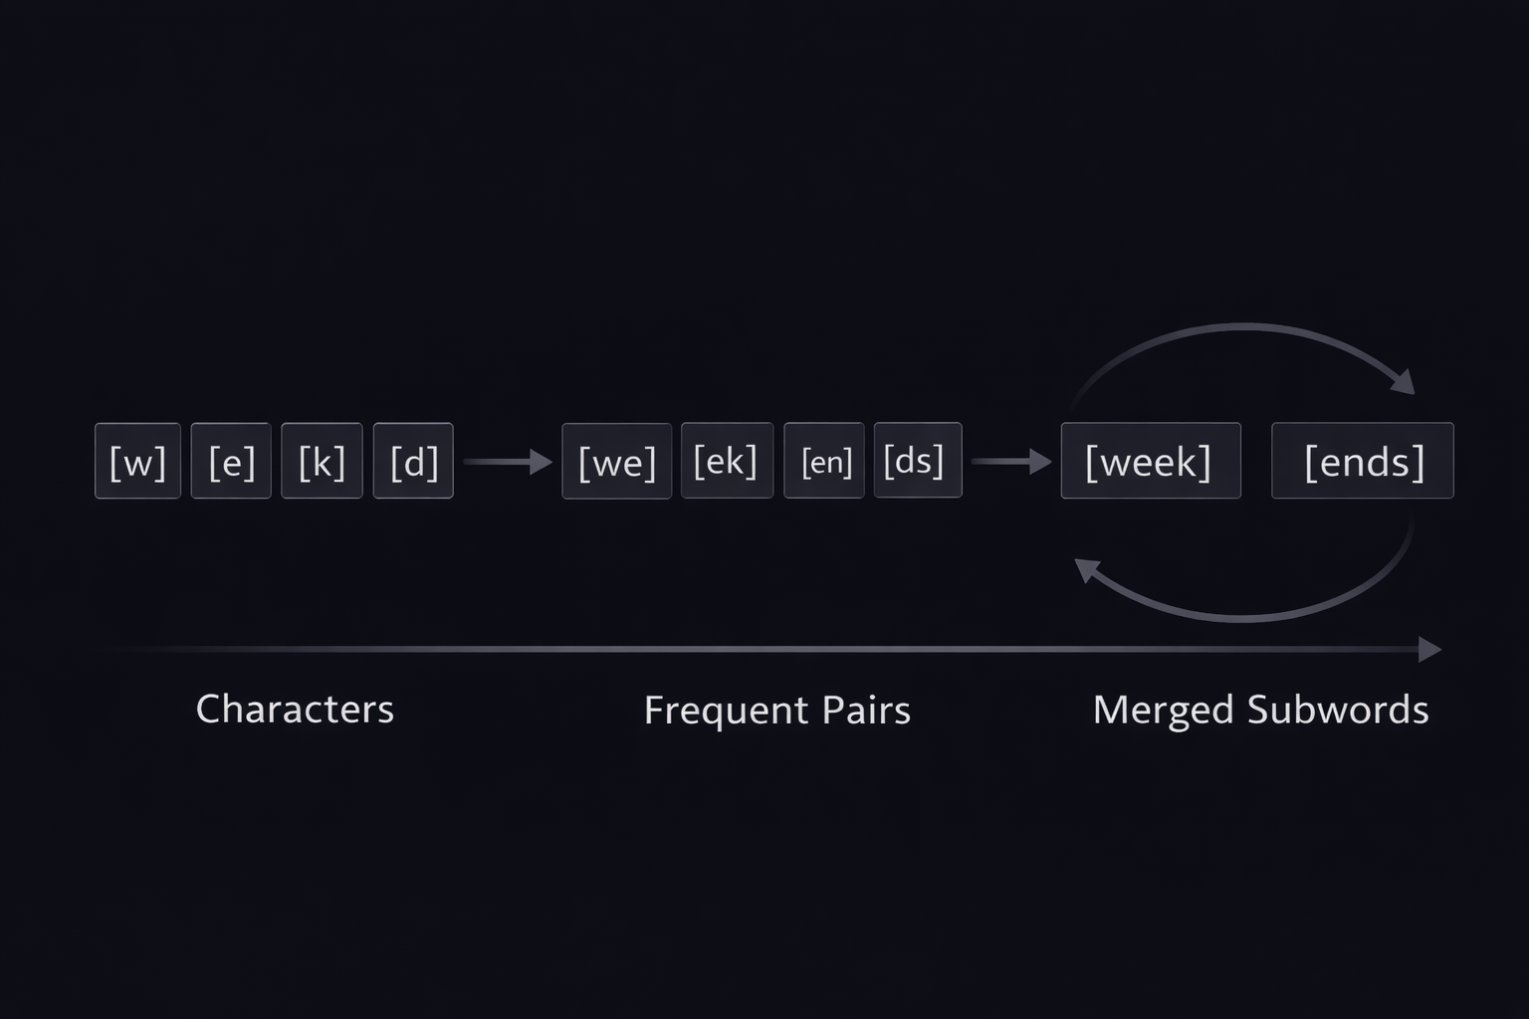
M01.1 BPE
Chapter 1.3 Byte-Pair Encoding (BPE) and Subword Tokenization
What Is Byte-Pair Encoding (BPE)?
Byte-Pair Encoding is an iterative subword tokenization algorithm.
It is based on frequency statistics from the training corpus.
The algorithm merges the most frequent adjacent token pairs.
Over time, meaningful subword units are learned.

Slide 18
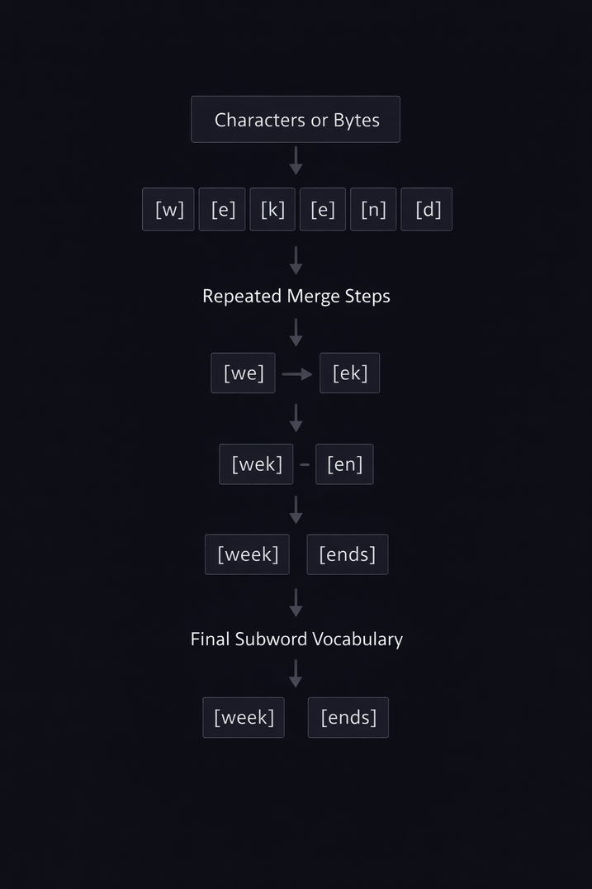
M01.1 BPE
Chapter 1.3 Byte-Pair Encoding (BPE) and Subword Tokenization
The BPE Training Process
Training starts from individual characters or bytes
All adjacent token pairs are counted across the dataset
The most frequent pair is merged into a new token
The process repeats until the target vocabulary size is reached

Slide 19
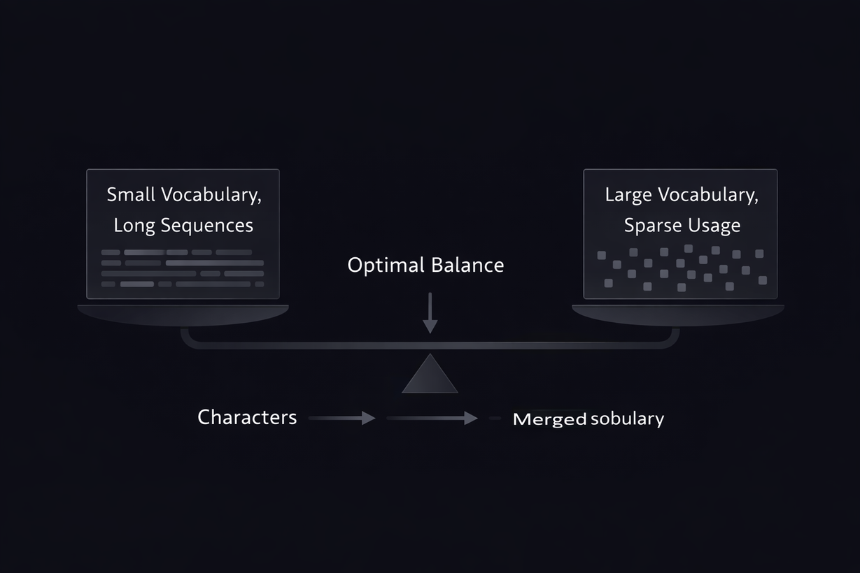
M01.1 BPE
Chapter 1.3 Byte-Pair Encoding (BPE) and Subword Tokenization
Vocabulary Size Trade-Offs in BPE
Small vocabularies increase sequence length
Longer sequences raise computational cost
Large vocabularies reduce fragmentation
Excessively large vocabularies introduce sparsity
Vocabulary size is a key design decision

Slide 20
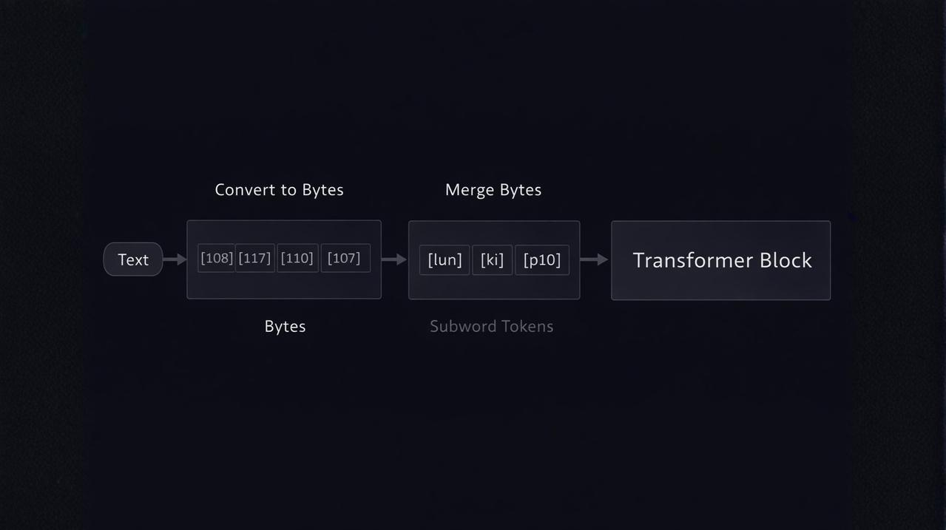
M01.1 BPE
Chapter 1.3 Byte-Pair Encoding (BPE) and Subword Tokenization
BPE in Transformer and GPT-Style Models
Modern Transformer models rely on subword tokenization.
Byte-level BPE ensures a fixed and complete base vocabulary.
This approach handles any character or symbol.
It enables efficient and scalable language modeling.

Slide 21
THEORY
Training Program 01
1. Getting Started with Text Processing
2. Fundamentals of Tokenization
3. Byte-Pair Encoding (BPE) and Subword Tokenization
4. Advanced Subword Tokenization with SentencePiece
5. Stopwords and Vocabulary Management
6. Processing Multilingual and Cross-Lingual Text
7. Summary and Next Steps

Slide 22
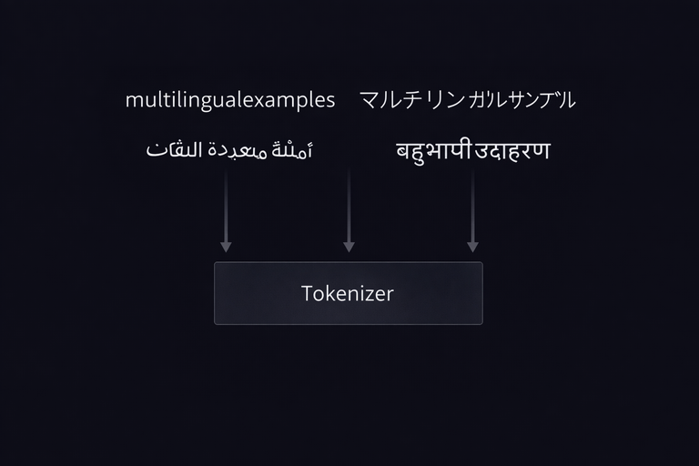
M01.1 BPE
Chapter 1.4 SentencePiece
Why SentencePiece Was Introduced
Traditional tokenizers rely on language-specific rules.
Whitespace-based pre-tokenization fails for many scripts.
SentencePiece processes text as a raw character stream.
This enables fully language-agnostic tokenization.

Slide 23
THEORY
Training Program 01
1. Getting Started with Text Processing
2. Fundamentals of Tokenization
3. Byte-Pair Encoding (BPE) and Subword Tokenization
4. Advanced Subword Tokenization with SentencePiece
5. Stopwords and Vocabulary Management
6. Processing Multilingual and Cross-Lingual Text
7. Summary and Next Steps

Slide 24
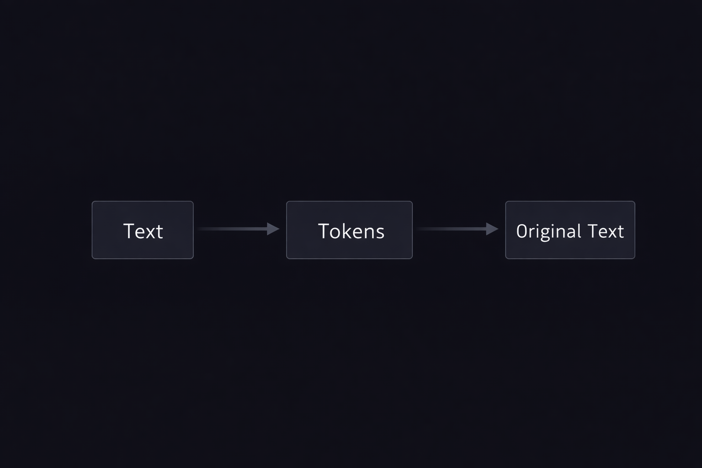
M01.1 BPE
Chapter 1.5 Stopwords and Vocabulary Management
Stopwords in Modern NLP Systems
Stopwords are high-frequency functional words.
Removing them was common in early NLP systems.
Transformer models rely on context and attention.
Modern pipelines often preserve stopwords.

Slide 25
THEORY
Training Program 01
1. Getting Started with Text Processing
2. Fundamentals of Tokenization
3. Byte-Pair Encoding (BPE) and Subword Tokenization
4. Advanced Subword Tokenization with SentencePiece
5. Stopwords and Vocabulary Management
6. Processing Multilingual and Cross-Lingual Text
7. Summary and Next Steps

Slide 26
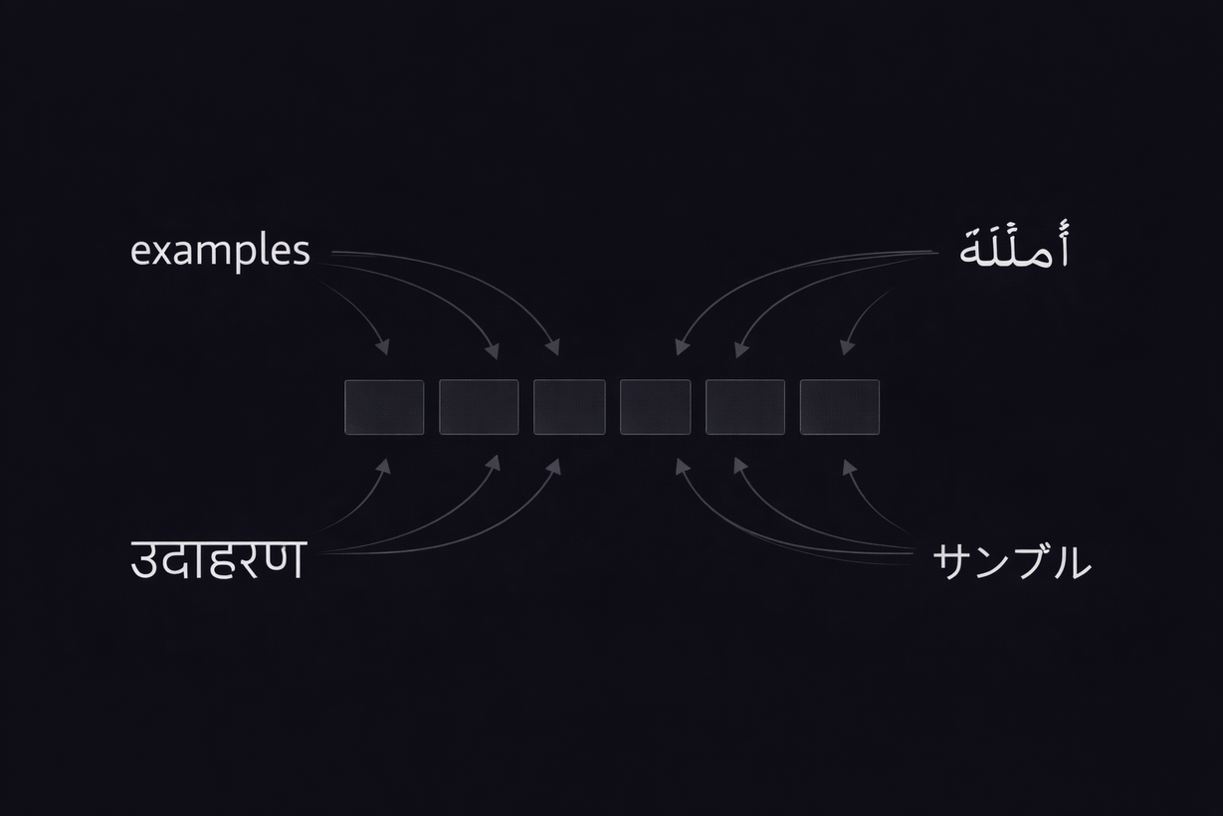
M01.1 BPE
Chapter 1.6 Processing Multilingual and Cross-Lingual Text
Challenges of Multilingual Tokenization
Languages differ in scripts and morphology.
Whitespace is not universal across languages.
Subword tokenization enables shared vocabularies.
This supports cross-lingual and zero-shot learning.

Slide 27
THEORY
Training Program 01
1. Getting Started with Text Processing
2. Fundamentals of Tokenization
3. Byte-Pair Encoding (BPE) and Subword Tokenization
4. Advanced Subword Tokenization with SentencePiece
5. Stopwords and Vocabulary Management
6. Processing Multilingual and Cross-Lingual Text
7. Summary and Next Steps

Slide 28
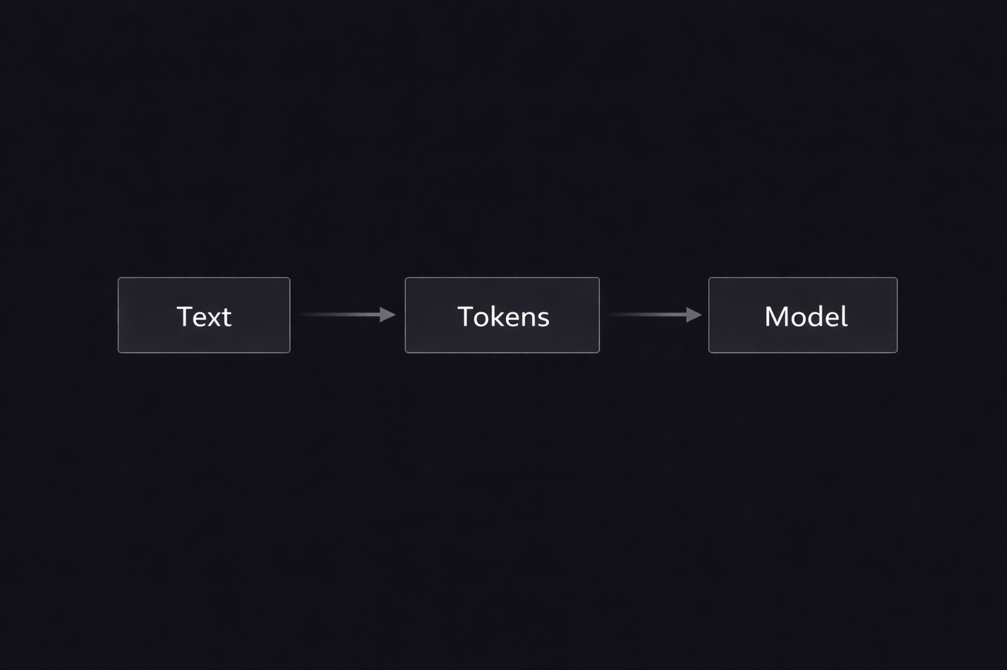
M01.1 BPE
Chapter 1.7 Summary and Next Steps
Key Takeaways from Text Preprocessing
Text preprocessing defines model capabilities.
Tokenization bridges language and mathematics.
Subword methods balance flexibility and efficiency.
Modern systems support multilingual inputs.

Slide 29
M01.1 BPE
Chapter 1.7 Summary and Next Steps
Recommended References and Learning Resources
Sebastian Raschka – Build a Large Language Model (From Scratch)
Sennrich et al. (2016) – Neural Machine Translation of Rare Words with Subword Units
Kudo and Richardson (2018) – SentencePiece: A Language-Independent Tokenizer
Radford et al. (2019) – Language Models are Unsupervised Multitask Learners
Hugging Face Course – Tokenization and NLP Fundamentals
OpenAI Documentation – Tokenizers and tiktoken

